Slide 1
Secondary Teacher Education Program
Fall Induction

Slide 2
School and community Experiences
Cara Gutzmer, Director
120E Education Building
217-333-2561 or caraknox@Illinois.edu
Sue Talbott, Clinical Experiences Specialist
120F Education
217-333-2561 or stalbott@Illinois.edu
Danielle Galardy, Office Manager
217-333-2561 or sce@education.Illinois.edu

Slide 3
SCE WEBSITE
http://education.illinois.edu/sce
The SCE website is for field placement information and clinical assignments. Please bookmark it and consult it frequently and when you have questions.
Secondary sequence of Professional Courses
Forms used in clinical experiences
Information for coops, supervisors, and students pertaining to clinical experiences
Career resources (limited)
Links to other sites

Slide 4
CoTE WEBSITE
Council on Teacher Education
http://www.cote.illinois.edu/
Student portal
Online evaluations
Criminal Background Check Instructions
Bloodborne pathogens training
Mandated Reporter Acknowledgement
Safety Training
Student teaching application
Conceptual Framework
Licensure Requirements

Slide 5
Vocabulary
Endorsements – Additional coursework that qualifies one to teach in specific areas/disciplines
Cohort – a group of students
Cooperating teacher (co-op) – teacher in your assigned classroom
Supervisor – University personnel that observe student teachers
Field experience, practicum – time in schools
edTPA – assessment of teacher performance, based on video and written commentary
Standards – expectations for teacher licensure
Observation – supervisor visit to classroom

Slide 6
VOCABULARY, CONT.
Seminar – a group meeting, usually with supervisor or methods instructors
Early field experience (EFE) – practica prior to student teaching
Student teaching – final semester experience; extended, daily time in the classroom
Student portal – individual site on CoTE website for record keeping

Slide 7
Entering the professional world
Your behavior is now open to public scrutiny. You live in a “fishbowl”.
Voicemail should be professional.
Internet information should be monitored for objectionable materials.
Demonstrate high standards of professional performance and attitude.
Make mature decisions for you and for your students.
Use discretion when discussing field experiences and maintain a tone of professional courtesy.

Slide 8
Professional responsibilities attendance
Arrive on time and stay for the duration of the scheduled field placement.
Honor the intended timeframe and sequence of your placement experience.
If absences or tardiness are necessary, communicate with the cooperating teacher and supervisor, where applicable, and make plans for makeup.
All absences must be made up.

Slide 9
Professional responsibilities attire
Professional dress
No flip flops
No jeans
Clothing should be conservative and comfortable
Tattoos covered up; piercings removed
Your appearance should not be a distraction to the learning in the classroom

Slide 10
Placement Policies
All placements are made and confirmed by SCE.
Placements are subject to change by SCE but not by student request.
Placements are made to assure work experience with diversity.
Placements are not made in a school where a close relative, friend, and/or significant other is employed.
UIUC student is responsible for completion of online evaluation by co-op and student.

Slide 11
Policies, cont.
You will also have a chance to confidentially evaluate each cooperating teacher.
Students are responsible for their own transportation to and from field placements. We use a variety of placements in and around C-U (a distance placement of over 30 miles may be possible).
BBP, Mandated Reporter, and Safety Training clearance required prior to entry into classroom. Criminal background checks are handled by each school district.
Absences must be made up.

Slide 12
FIRST YEAR
Spring 2021 CI 401
Field placement in High School
45 hours in placement
3 hours arranged per week
Follow UIUC calendar
60-mile radius of C-U campus
Evaluated by cooperating teacher

Slide 13
SECOND YEAR
Fall 2021 CI 403
Spring 2022 EDPR 442
Field placement in High School
90 hours in placement
6 hours per week; minimum 2 hours per visit
Follow UIUC calendar
60 mile radius of C-U campus
Evaluated by University supervisor
Local, CPS, NW suburbs
16-17 weeks in placement, 4-5 weeks of full take over
Evaluated by University Supervisor
Evening seminars (vary by location)
Follow assigned school calendar (starts after school’s winter break)
CI 404 online class (Wednesdays @ 6PM)

Slide 14
Student Teaching Application
DUE by October 9.
Log into the CoTE portal (http://cote.illinois.edu/) > click on Student Teaching Form Application
Fill out the appropriate sections based on your program and as accurately as you can at this time.
If your personal information changes (car, contact number, interest in pursuing ELL/bilingual approvals), please email Cara Gutzmer (caraknox@illinois.edu) right away

Slide 15
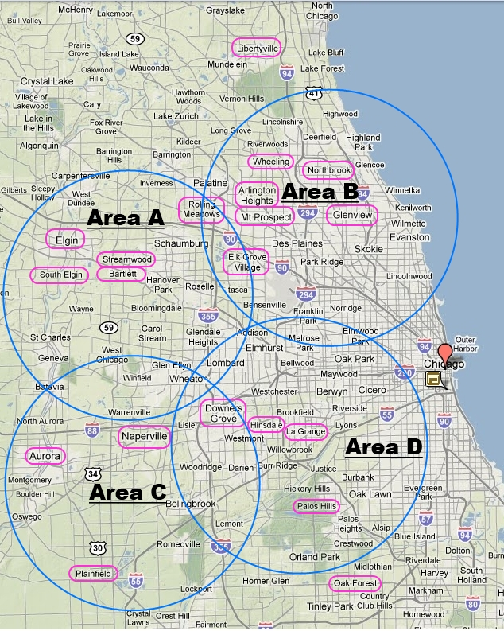
Student Teaching Application
Areas are shown on the Northwest Suburb Map
Area A – Elgin area
Area B – Arlington
Heights/Glenview area
Area C – Naperville/
Aurora area
Area D – Hinsdale/
La Grange area
Map link located
under specific program
main page
Cannot student teach where
You went or have family
If you prefer Local or CPS;
Enter that as only request

Slide 16
IMMEDIATE assignments
Bookmark SCE and CoTE website for use during the next two years in teacher education.
Familiarize yourself with both websites.
After November 1 and before December 15, IF NECESSARY, clear the Criminal Background Check; districts will share requirements, as necessary.
Now, you can complete Bloodborne Pathogens Training; Safety Training (DUE by Dec 15)
Mandated Reporter Training will occur during a MANDATORY CoTE orientation (TBD)
Start thinking about housing and transportation for 2020-2021

Slide 17
Upcoming meetings
Resume/cover letter workshops
October 14- 4 to 5:30PM
October 19- 7 to 8:30PM
CI 401 placement orientation
October 22- 6 to 7:30PM

Slide 18
announcements
Watch for IMPORTANT e-mails from sce@education.illinois.edu
When emailing with a question, identify the teacher program and year you are in program.
When responding to email, always hit the reply (not reply all) so our office has an historical understanding of the email.
Read through websites for instructions and information before calling or emailing for assistance.
Keep your mailbox cleaned out.
Use Illinois account.

Slide 19
Welcome to the College of Education
Make the most of your two year career preparation

