Slide 1
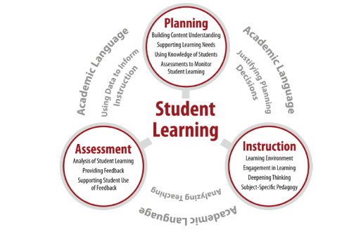
EdTPA: Elementary Literacy
December 15, 2015

Slide 2
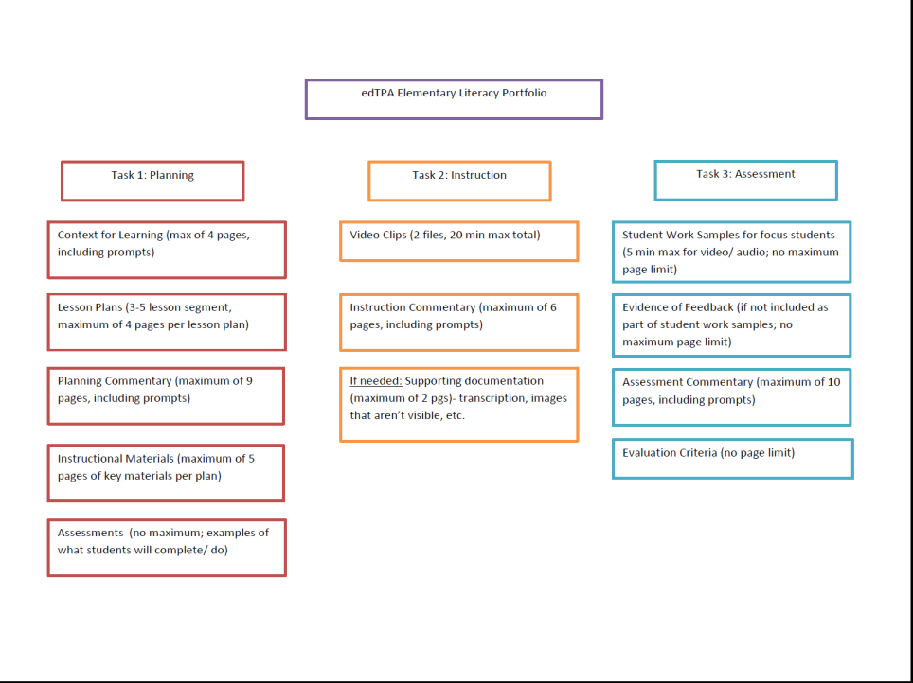
The Big Picture
Notes:
9:00-9:15

Slide 3
Evidence Chart, Page 41
Notes:
9:15-9:20
Here is where we can discuss Edthena and how that will help

Slide 4
Task 1: Planning for Instruction and Assessment
In Task 1, you will…
Plan a learning segment of 3-5 consecutive lessons
Determine a central focus for this learning segment
Submit lesson plans
Respond to commentary prompts prior to teaching the learning segment
Submit copies of all directions, assessments, etc. for any portion of the learning segment
Notes:
9:20-9:30

Slide 5
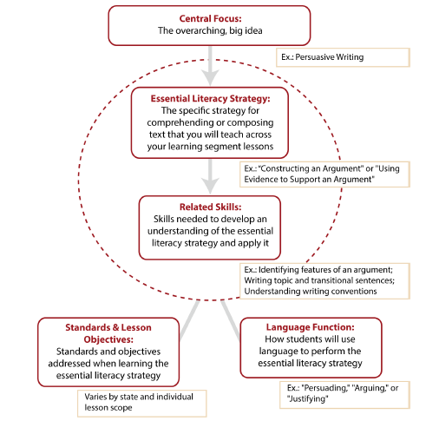
Central Focus
See p. 46 of Handbook: central focus: A description of the important understandings and core concepts that you want students to develop within the learning segment. The central focus should go beyond a list of facts and skills, align with content standards and learning objectives, and address the subject-specific components in the learning segment.
Notes:
9:30-9:40
In elementary literacy, the central focus is an overarching, big idea for student learning in literacy. The subject-specific components for the elementary literacy central focus also include (a) an essential literacy strategy tied to the central focus and (b) related skills.

Slide 6
Review Task 1 Exemplar
Notes:
9:40-10:10

Slide 7
Break Time!
GoNoodle
Notes:
10:10-10:15

Slide 8
Task 2: Instructing and Engaging Students in Learning
In Task 2, you will…
Obtain required permissions for videorecording your students and any adults in the video
Choose lessons from Task 1 to be videorecorded
Videorecord your teaching and select 2 video clips (no more than 20 minutes total)
Analyze your teaching and your students’ learning by responding to commentary prompts
Notes:
10:15-10:25
When you choose lessons from Task 1, you want to choose lessons that show you interacting with students to support them to independently apply the literacy strategy

Slide 9
Task 2 Exemplar
Notes:
10:25-10:50

Slide 10
Break Time!
Please return in 10 minutes!
Notes:
10:50-11:00

Slide 11
Task 3: Assessing Student Learning
In Task 3, you will…
Select one assessment from the learning segment that you will use to evaluate knowledge and skills. You will attach this assessment to the end of the commentary.
Define and submit the evaluation criteria
Collect and analyze student work
Select three student work samples (“focus students”)
Submit feedback for the work samples for those three students in written, audio, or video form
Analyze evidence of student learning by responding to commentary prompts
Notes:
11:00-11:10

Slide 12
Academic Language
academic language: Oral and written language used for academic purposes. Academic language is the means by which students develop and express content understandings. Academic language represents the language of the discipline that students need to learn and use to participate and engage in the content area in meaningful ways. There are language demands that teachers need to consider as they plan to support student learning of content. These language demands include language functions, vocabulary, discourse, and syntax.
PassedTPA description
See p. 46 in the Handbook for the Glossary
Notes:
11:10-11:20

Slide 13
Task 3 Exemplar
Notes:
11:20-11:40

Slide 14
Handbook Review
The following sections are especially helpful:
Tasks Overview – beginning on p. 5
Task 1 – beginning on p. 8
Task 1 Planning Rubrics – beginning on p. 14
Task 2 – beginning on p. 19
Task 2 Instruction Rubrics – beginning on p. 23
Task 3 – beginning on p. 28
Task 3 Assessment Rubrics – beginning on p. 32
Evidence Chart – beginning on p. 41
Glossary – beginning on p. 46
You are responsible for reading and being familiar with ALL of the information in your handbook.
Notes:
11:40-11:45
To say:
The commentary prompts are in your handbook, but you will answer using the Word Docs on the EDPR 203 Moodle

Slide 15
Rubric Level Progressions
Notes:
11:45-11:55

