Slide 1

Electronic Observations for Supervisors
Your guide to completing the electronic observation forms for the School and Community Experiences Office.
Updated 1-9-15

Slide 2
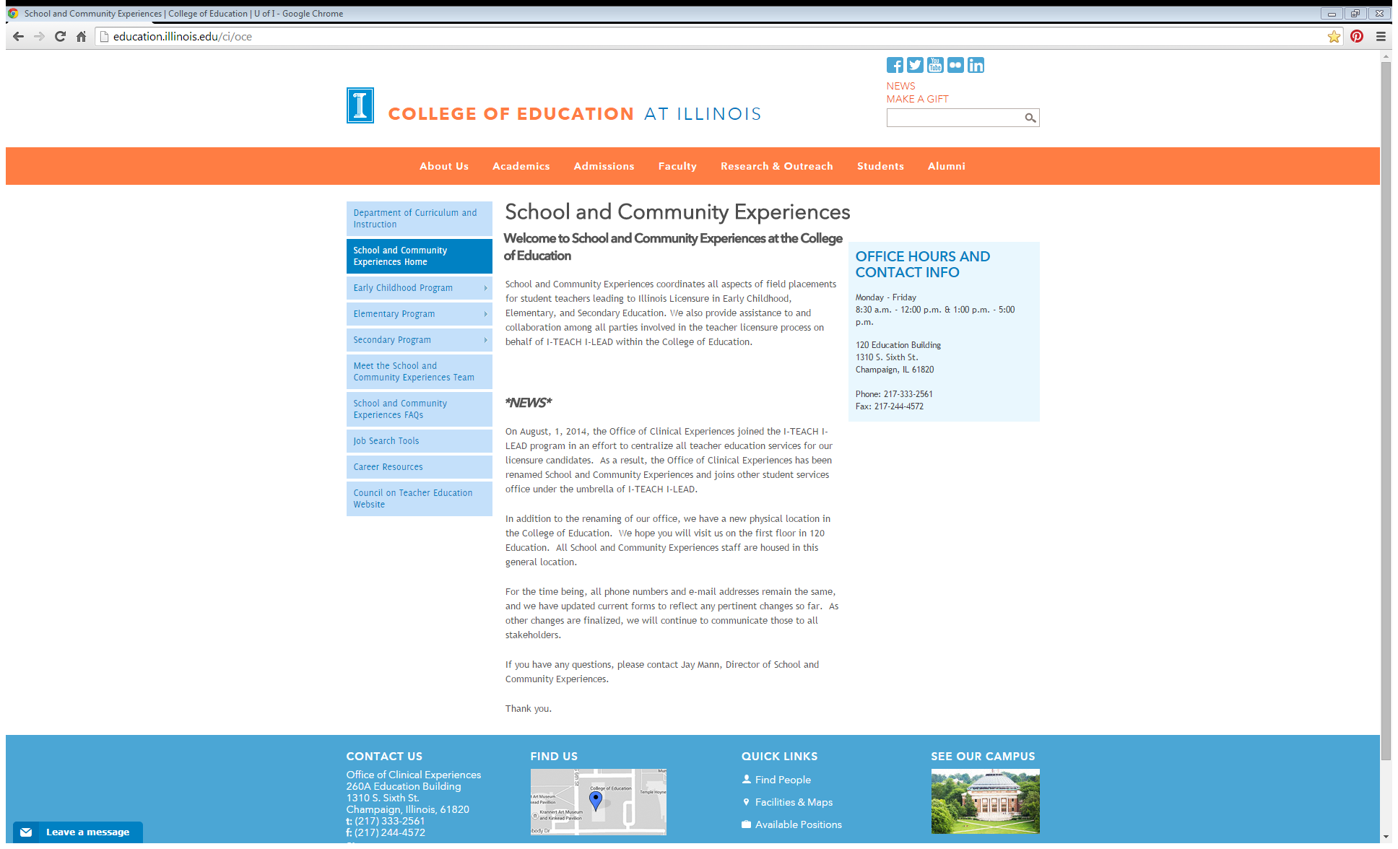
The Website:
The School and Community Experiences website is a very beneficial resource, so please bookmark it and check back often.
http://education.illinois.edu/ci/oce
Are you a supervisor for the Early Childhood program? Elementary? Secondary?
The information that will be most beneficial to you is found under the specific program you participate it.

Slide 3
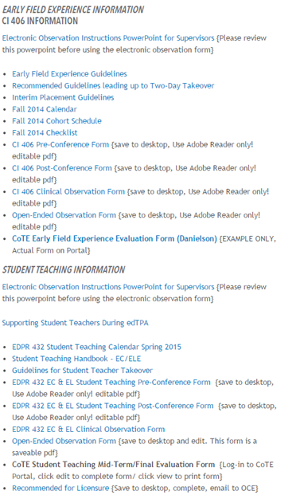
Supervisor Webpage:
Example
The two electronic observation forms that are used are the –
Open-Ended Observation Form
(editable/saveable pdf)
Structured/Student Teaching Observation Form
(selectively editable word doc)
Both electronic forms are located under Student Teaching Information, but they can also be found under Early Field Experience Information if they are used as they are under the Elementary Program.

Slide 4
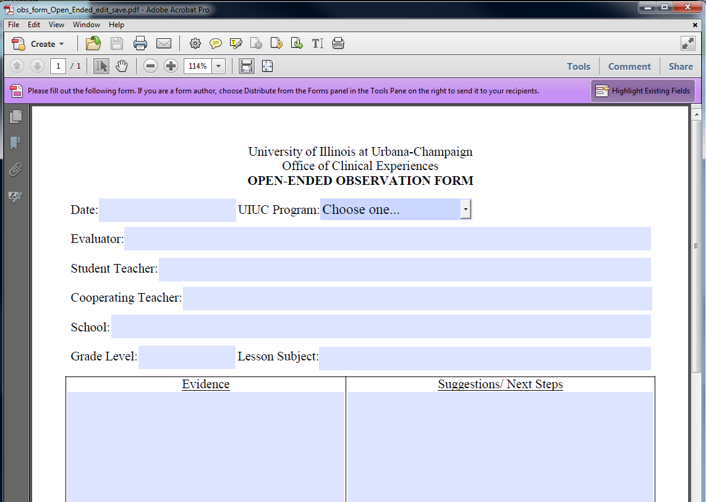
The Open-Ended Form:
Click the “Open-Ended Observation Form” link. Save the form to your desktop as a starting point.
You will be able to edit the fields and save the data. SCE requires you to name the document using a certain format and we will cover that in a few slides.
Here is what the form looks like.
MAC Users: When you open this document, please make sure in the top-left corner of your monitor it reads ADOBE READER!
If it reads anything other than Adobe Reader, the form will not save correctly! Please contact our office as soon as possible to correct this issue before you start your observations.

Slide 5
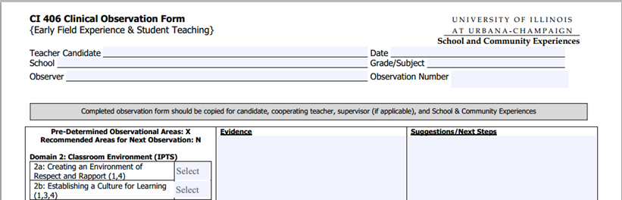
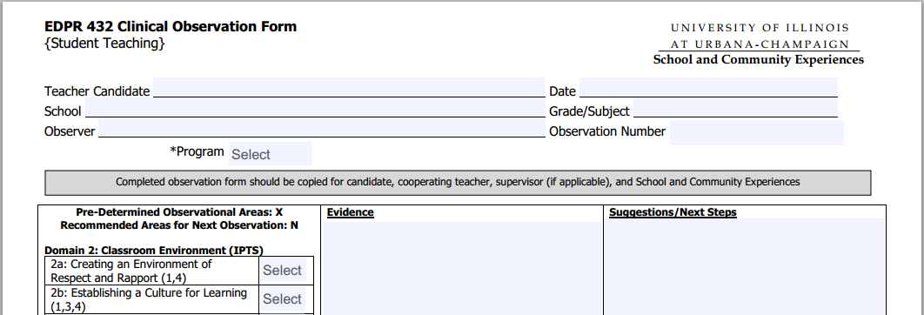
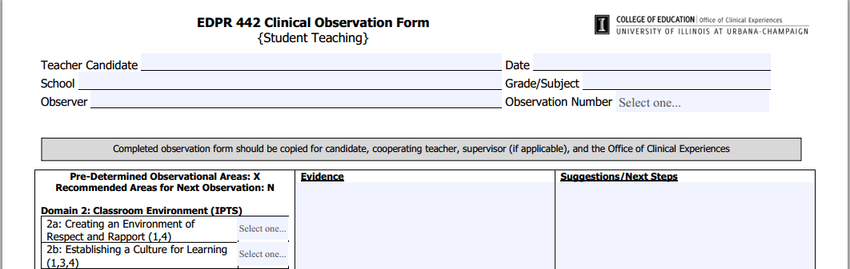
The Structured/ Student Teaching Form:
This form is used for CI 406, EDPR 432 EC & EL, and EDPR 442. Look for the (electronic version) tag.
Save it to your desktop as a starting point.
This doc is locked for limited editing, but you can add text in the heading, comments, etc. Also, you can change the ratings via a drop-down menu. The tab button can help you move quickly through the document.
* EDPR 432 Form:
The Program field
is a drop-down
menu, so select
either Elementary
or Early Childhood

Slide 6
Saving the Form:
The most common method of saving a .doc and a .pdf is to click on the File tab and Save As.
This allows you to choose where to save the file and how to name it.
How you name these documents are very important so please make sure you use the same name and spelling every time. Otherwise, the filing system will be incorrect.
It’s no fun looking for misplaced files!

Slide 7
Naming the Form:
CI 406 Supervisors:
  406 OF – Marshall, Hallie Hillman 1-31-13 #1
  406 OF – Marshall, Hallie Hillman 2-15-13 #2
EDPR 432 EC Supervisors:
  432 EC OF – Marshall, Hallie Hillman 1-31-13 #1
  432 EC OF – Marshall, Hallie Hillman 2-15-13 #2
EDPR 432 EL Supervisors:
  432 EL OF – Marshall, Hallie Hillman 1-31-13 #1
  432 EL OF – Marshall, Hallie Hillman 2-15-13 #2
EDPR 442 Supervisors:
  442 OF – Marshall, Hallie Hillman 1-31-13 #1
  442 OF – Marshall, Hallie Hillman 2-15-13 #2
IF an open-ended & a structured form are used during the same observation, add an A & a B after the last number. i.e. #1A, #1B
Please use the appropriate naming format for your supervisory role!
Naming Theme Explained:
The first number is the clinical course number for the U of I
OF stands for Observation Form
Student Last name, then Student First Name
Supervisor Last name for ID
Date of the observation
Number of times observed

Slide 8
Sending the Form:
Questions?
Once the form is complete and saved correctly, please send it to the appropriate recipients.
Send it to the student, the cooperating teacher, and to SCE.
(schoolcommunityexp@education.illinois.edu)
It is recommended you keep a record of when and which forms you have sent for reference and accountability.
Email Denise at
djayne@illinois.edu or
Sunny at
koerber@illinois.edu

